Slide 1
Simplify Your AVD Update strategy
- Sander Rozemuller

Slide 4
The problem
4
Complex Azure Virtual Desktop update mechanism. Session host replacement (Entra ID & Intune)

Slide 5
Agenda
Image update process
The current image process
The ‘new’ way
NEW feature: AVD Host pool update explained
Key takeaways:
Monitoring
Simplify AVD session host deployment
Roll back image
How to monitor the process
Automation
How to use the process in automation
Rollback
The rollback process explained

Slide 6

About Sander Rozemuller
Focus
Awards
Automation, AVD, Intune
Microsoft Most Valuable Profesional
From
Hobbies
Picture
Netherlands
BBQ, Brewing Beer, Tech
My Blog
Do for living
rozemuller.com
Freelance IT automation consultant & developer

Slide 7
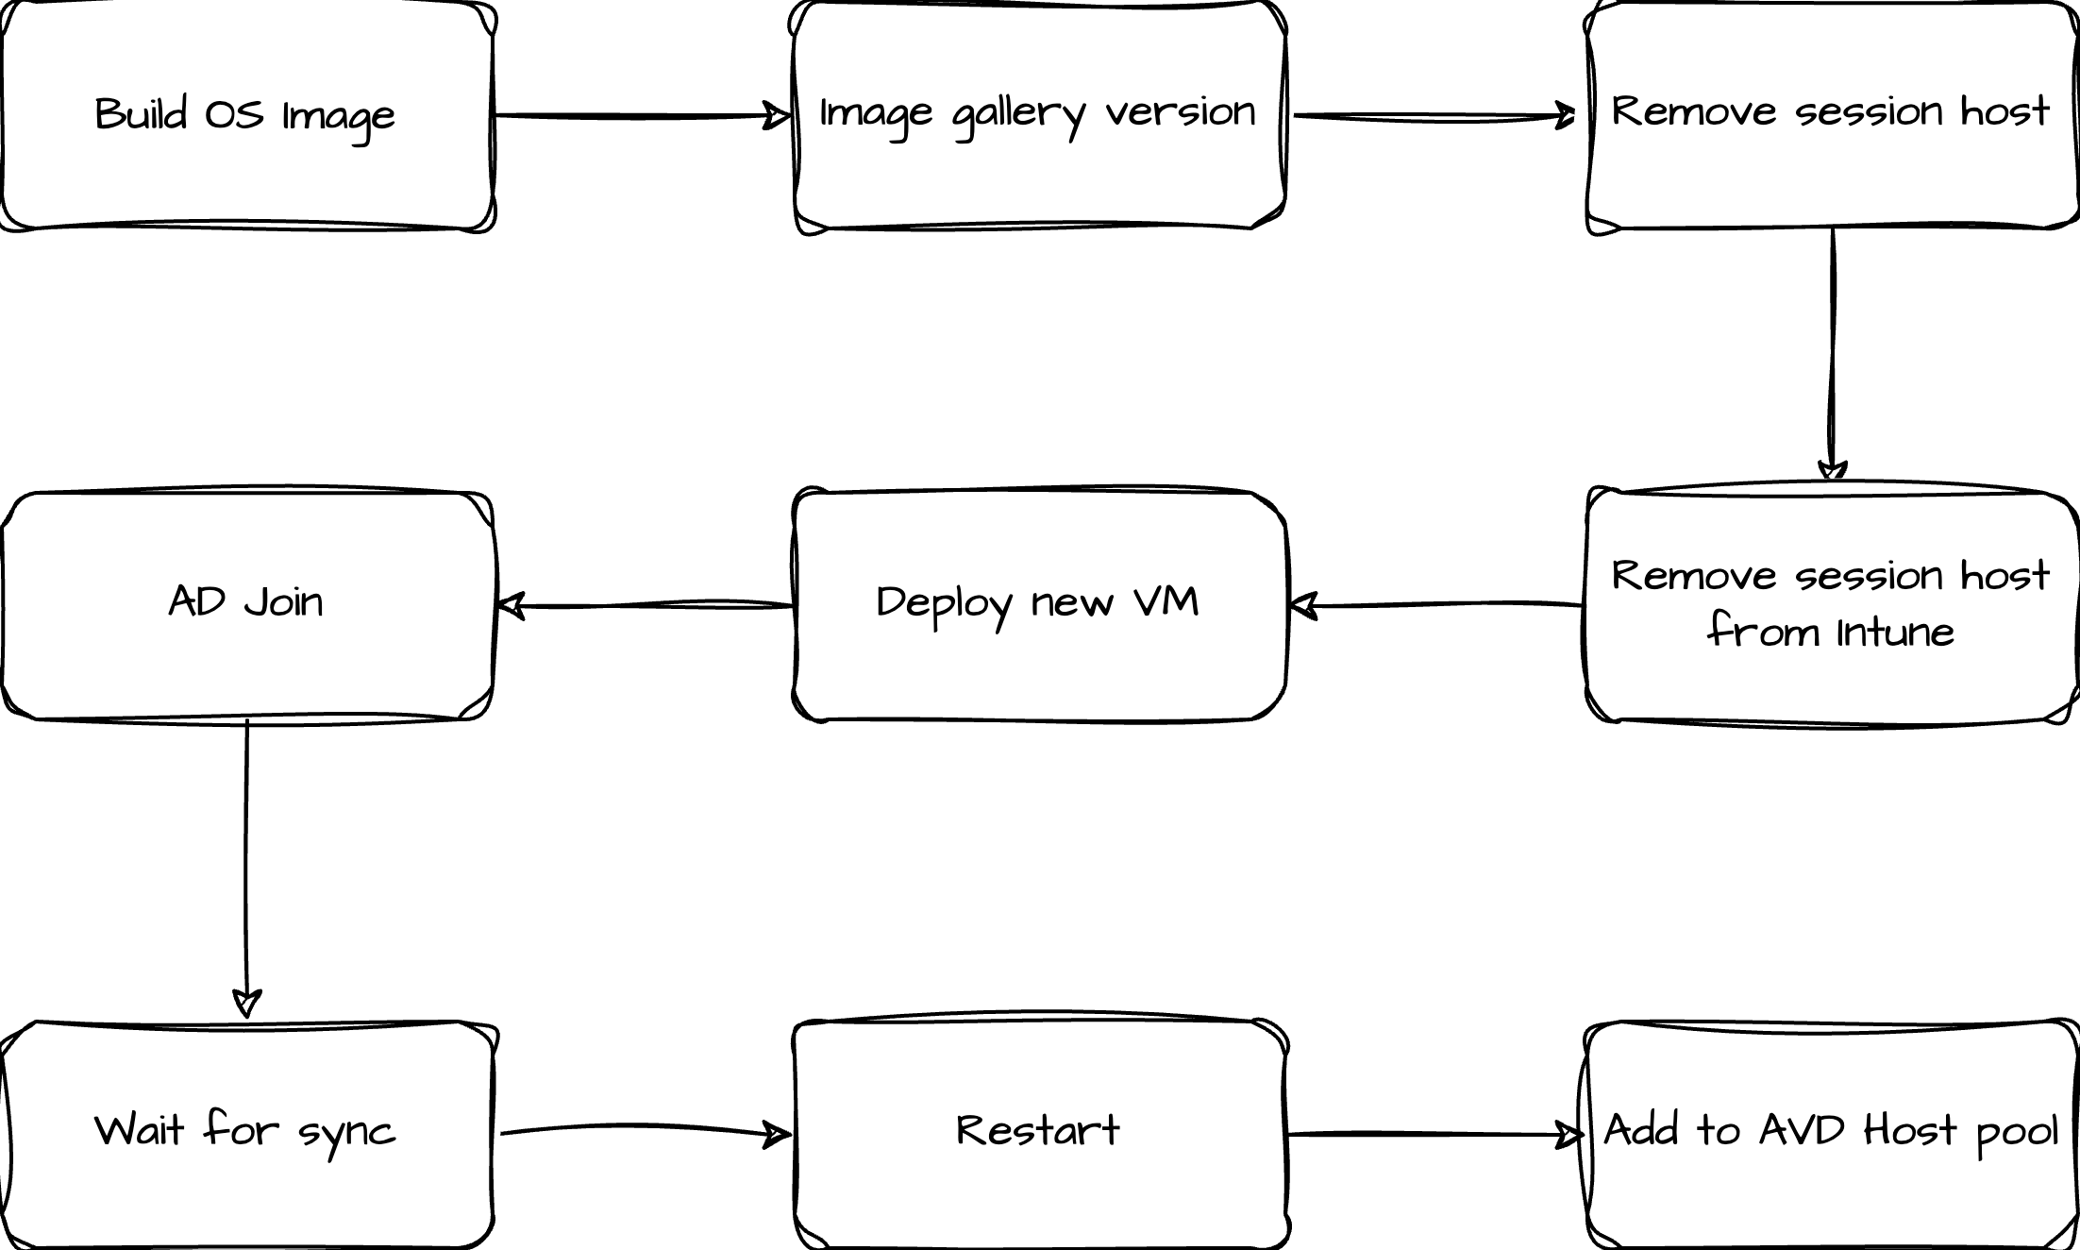
The image update process

Slide 8

The ‘new’ update process

Slide 9
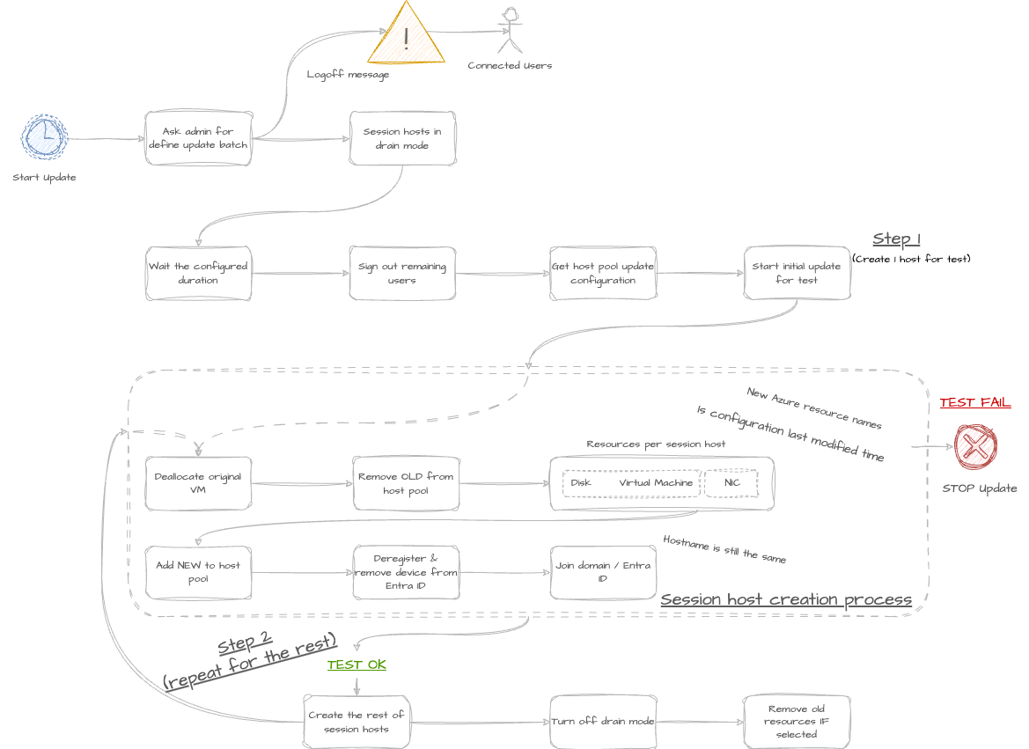
How does it work

Slide 10
How to configure
AVD VM template
Image Gallery with versions
Azure Key Vault

Slide 11
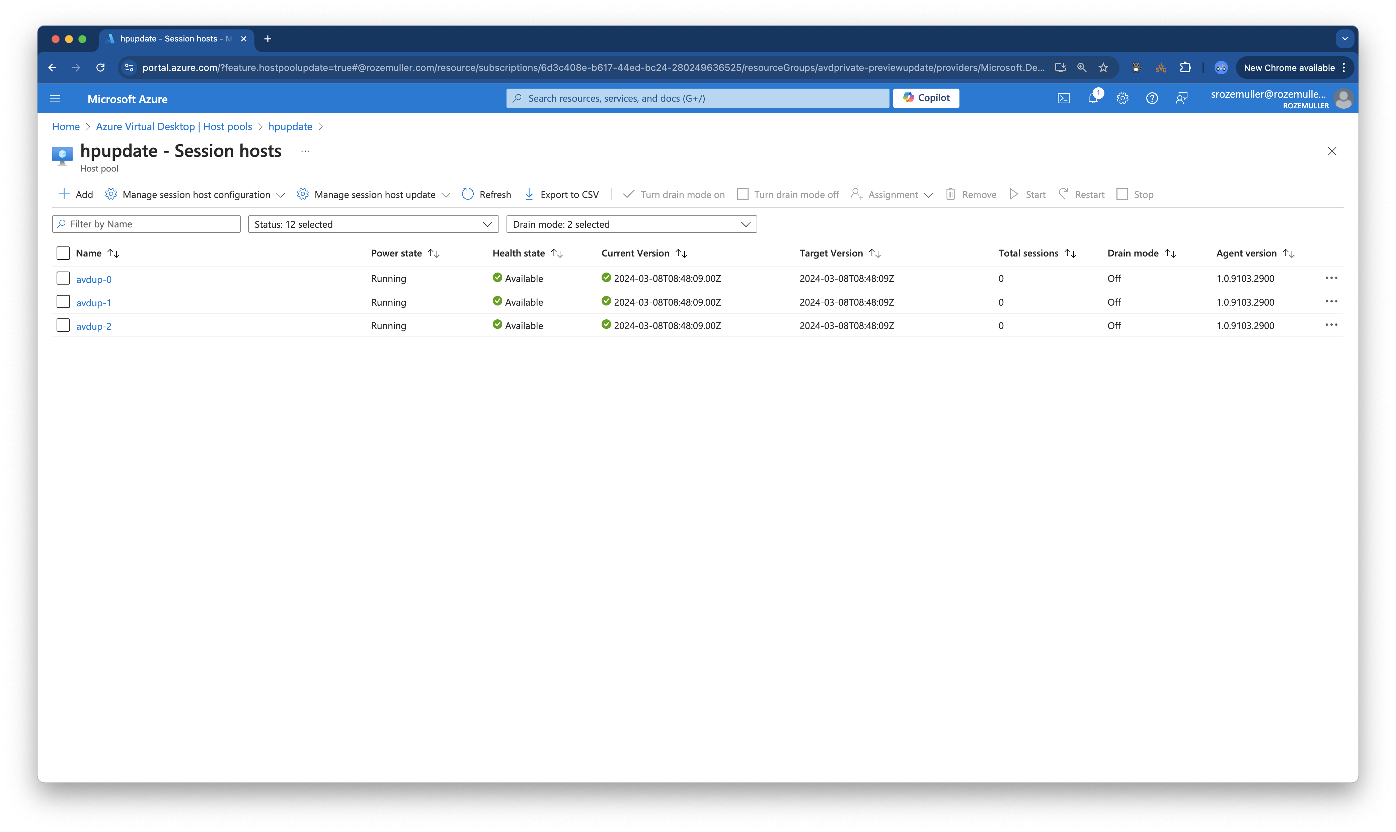
Host pool update

Slide 12
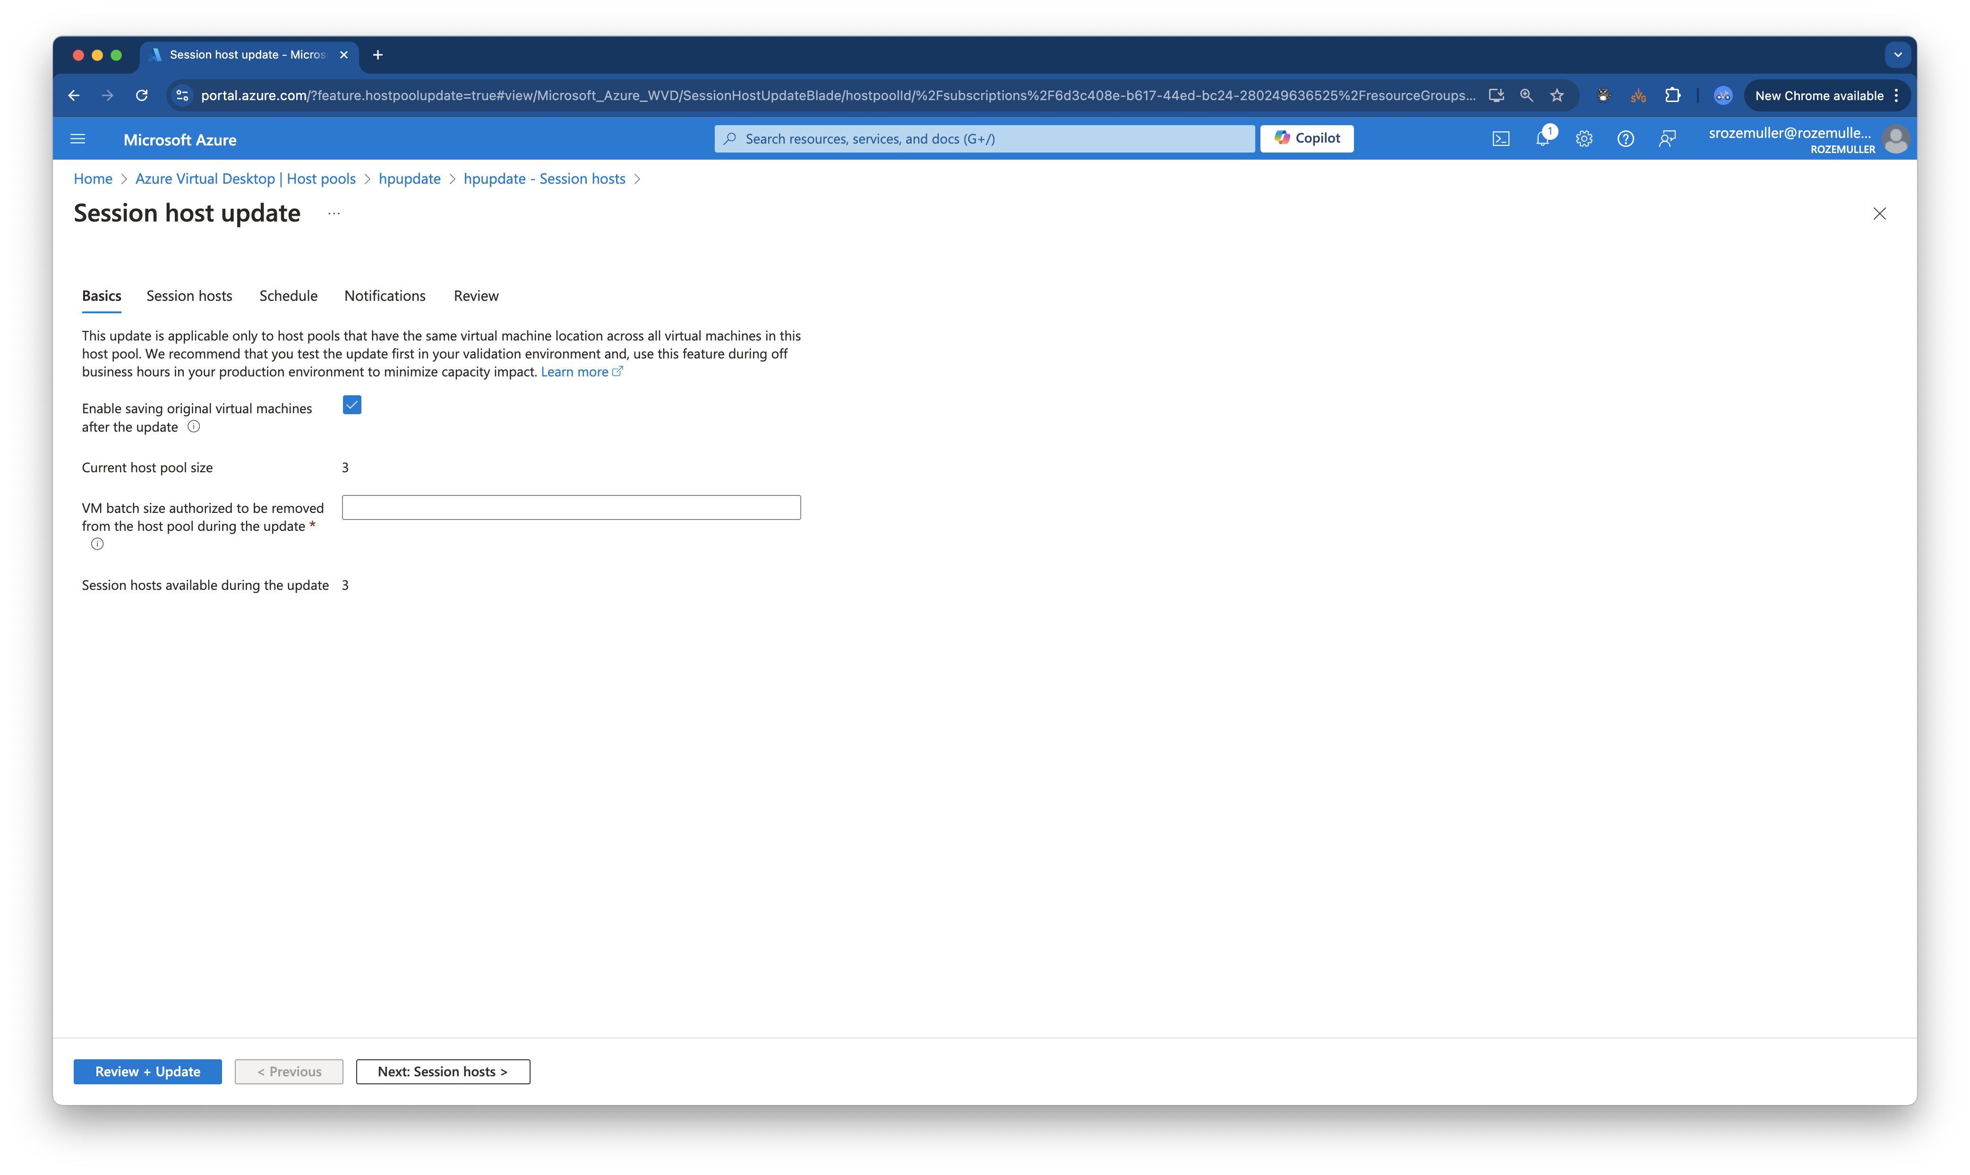
Host pool basics

Slide 13
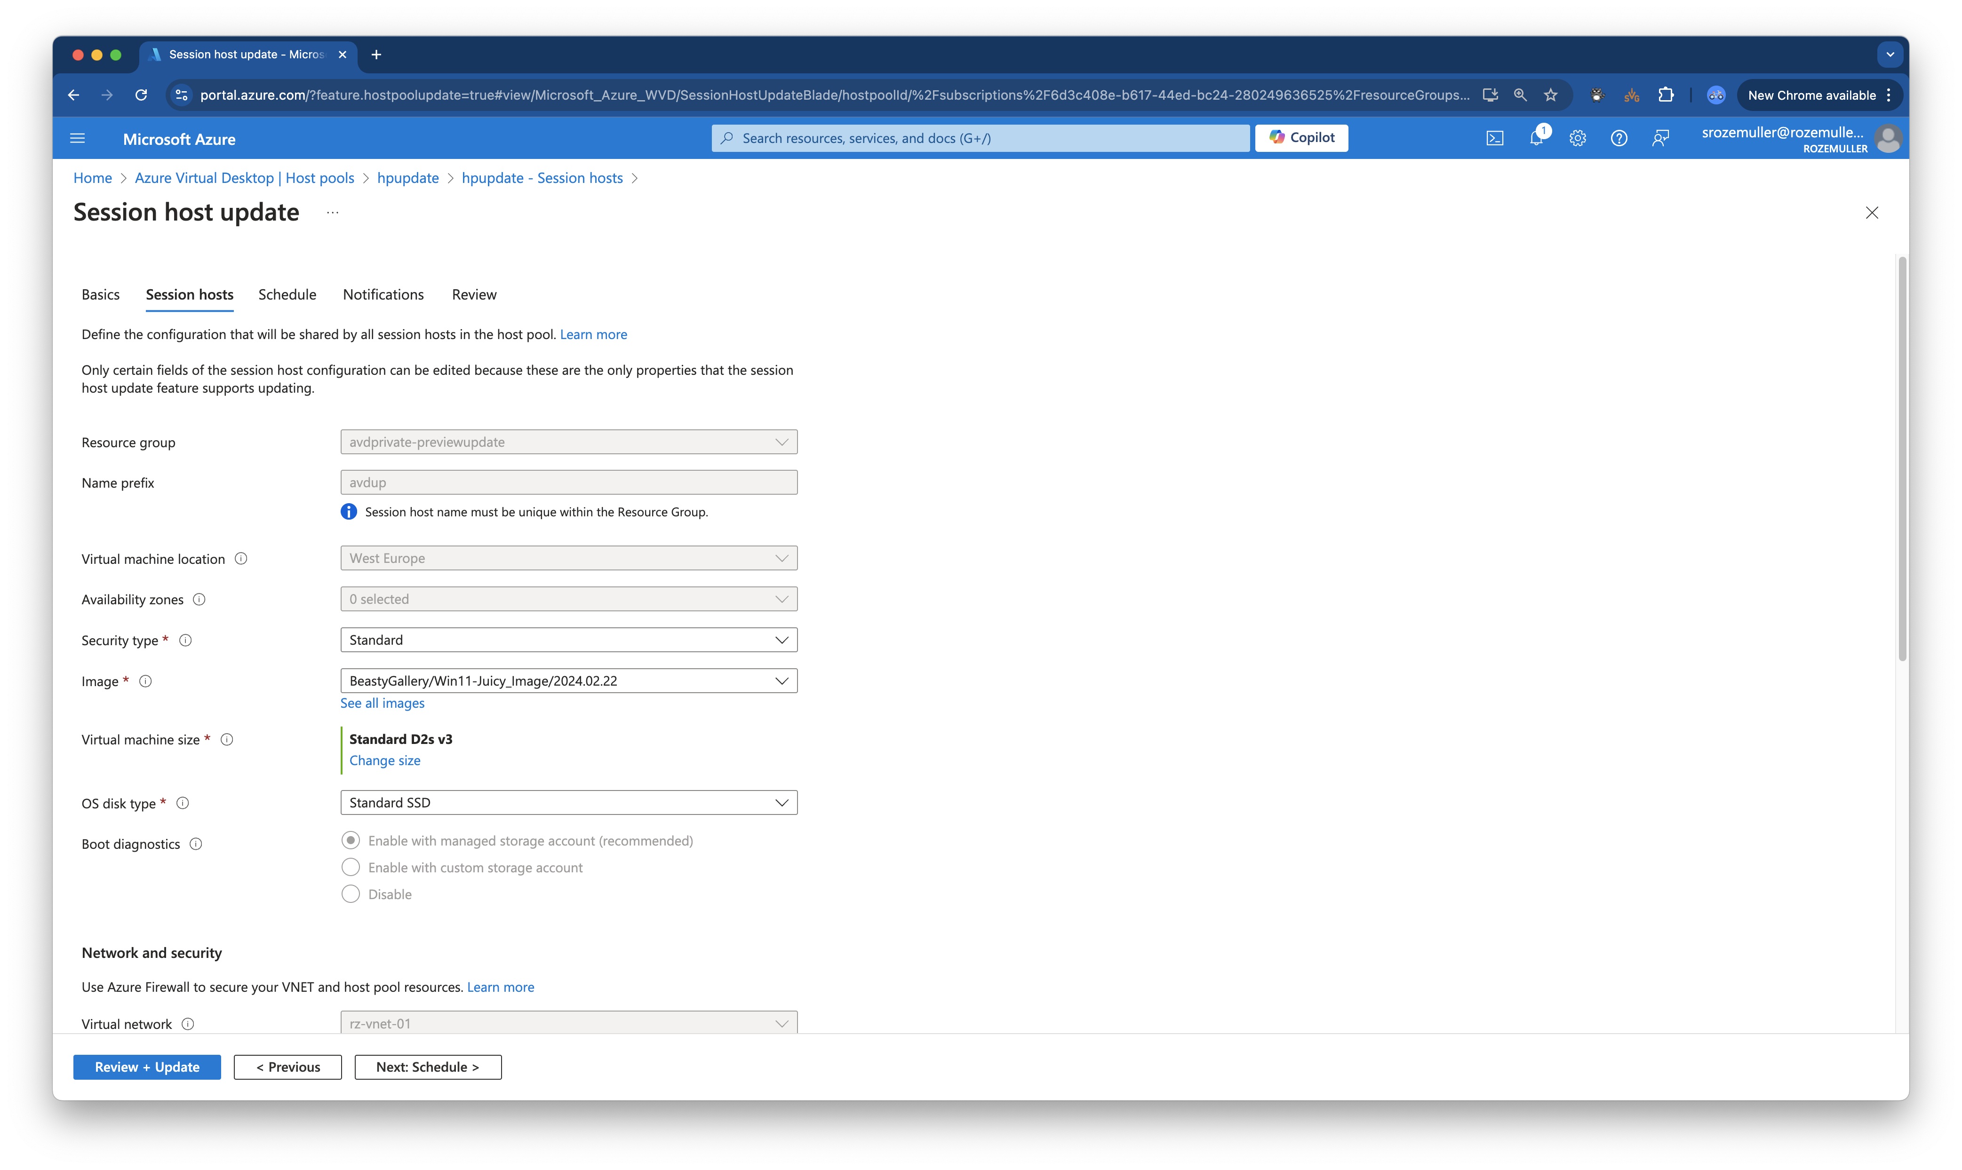
Host pool deployment config

Slide 14
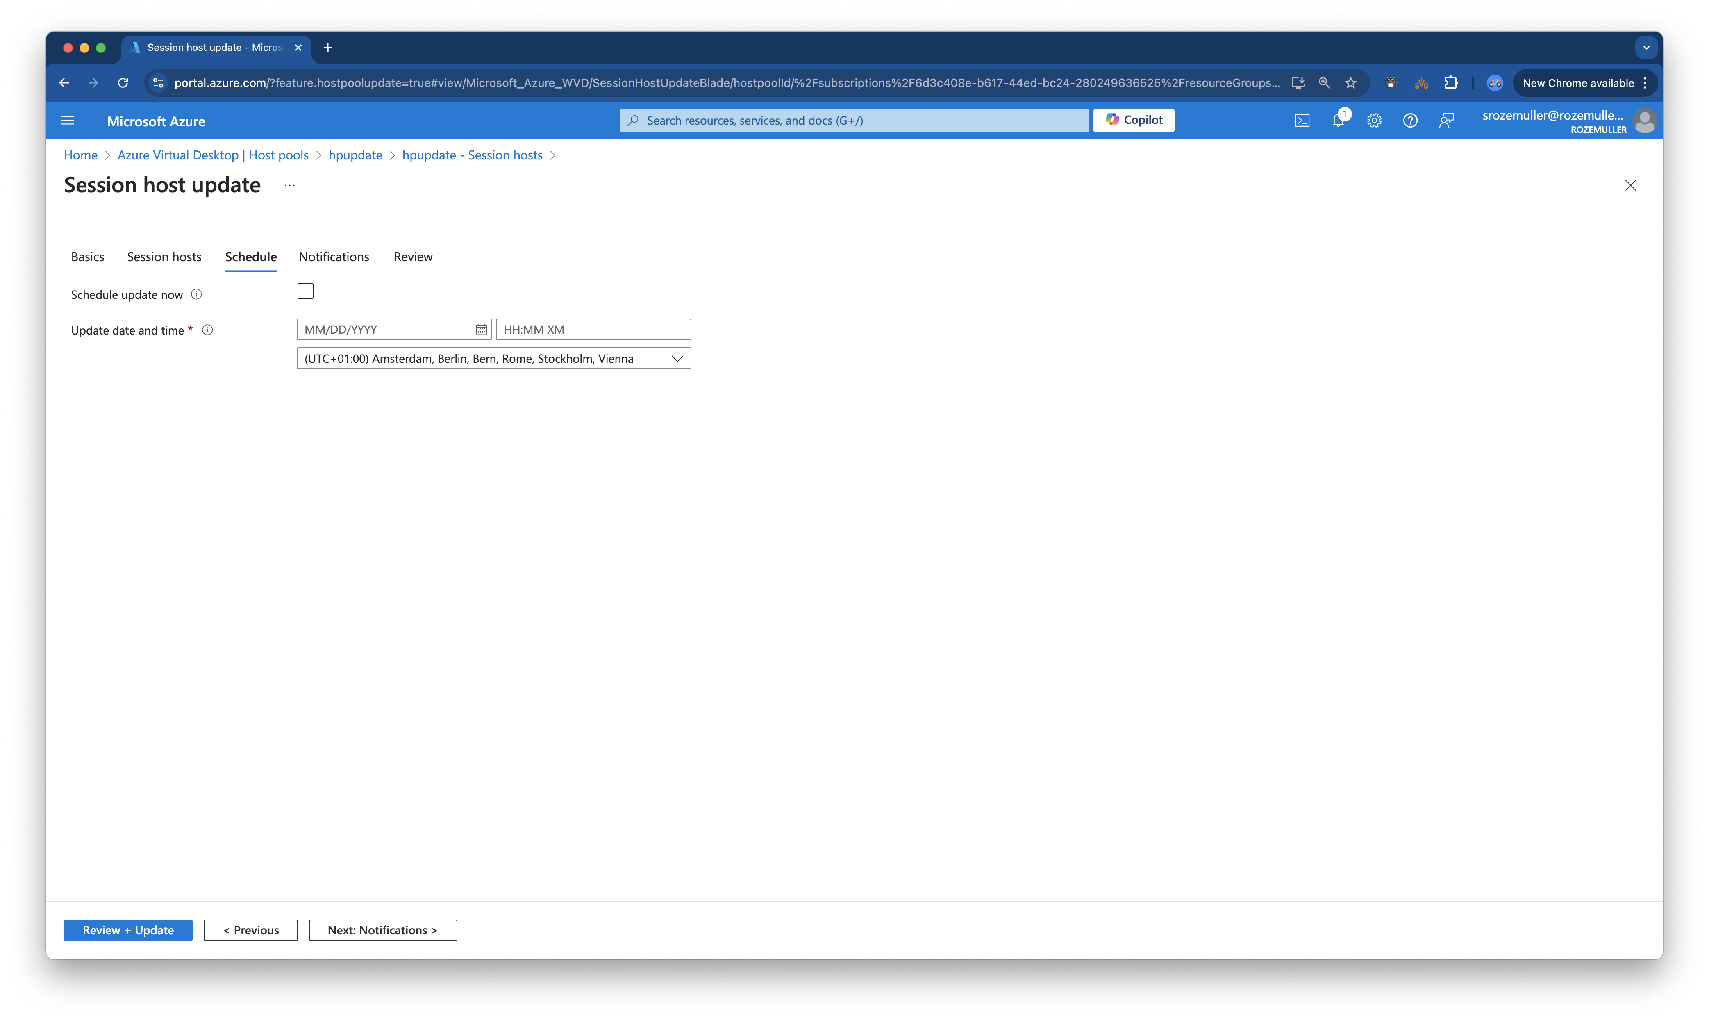
Update schedule

Slide 15
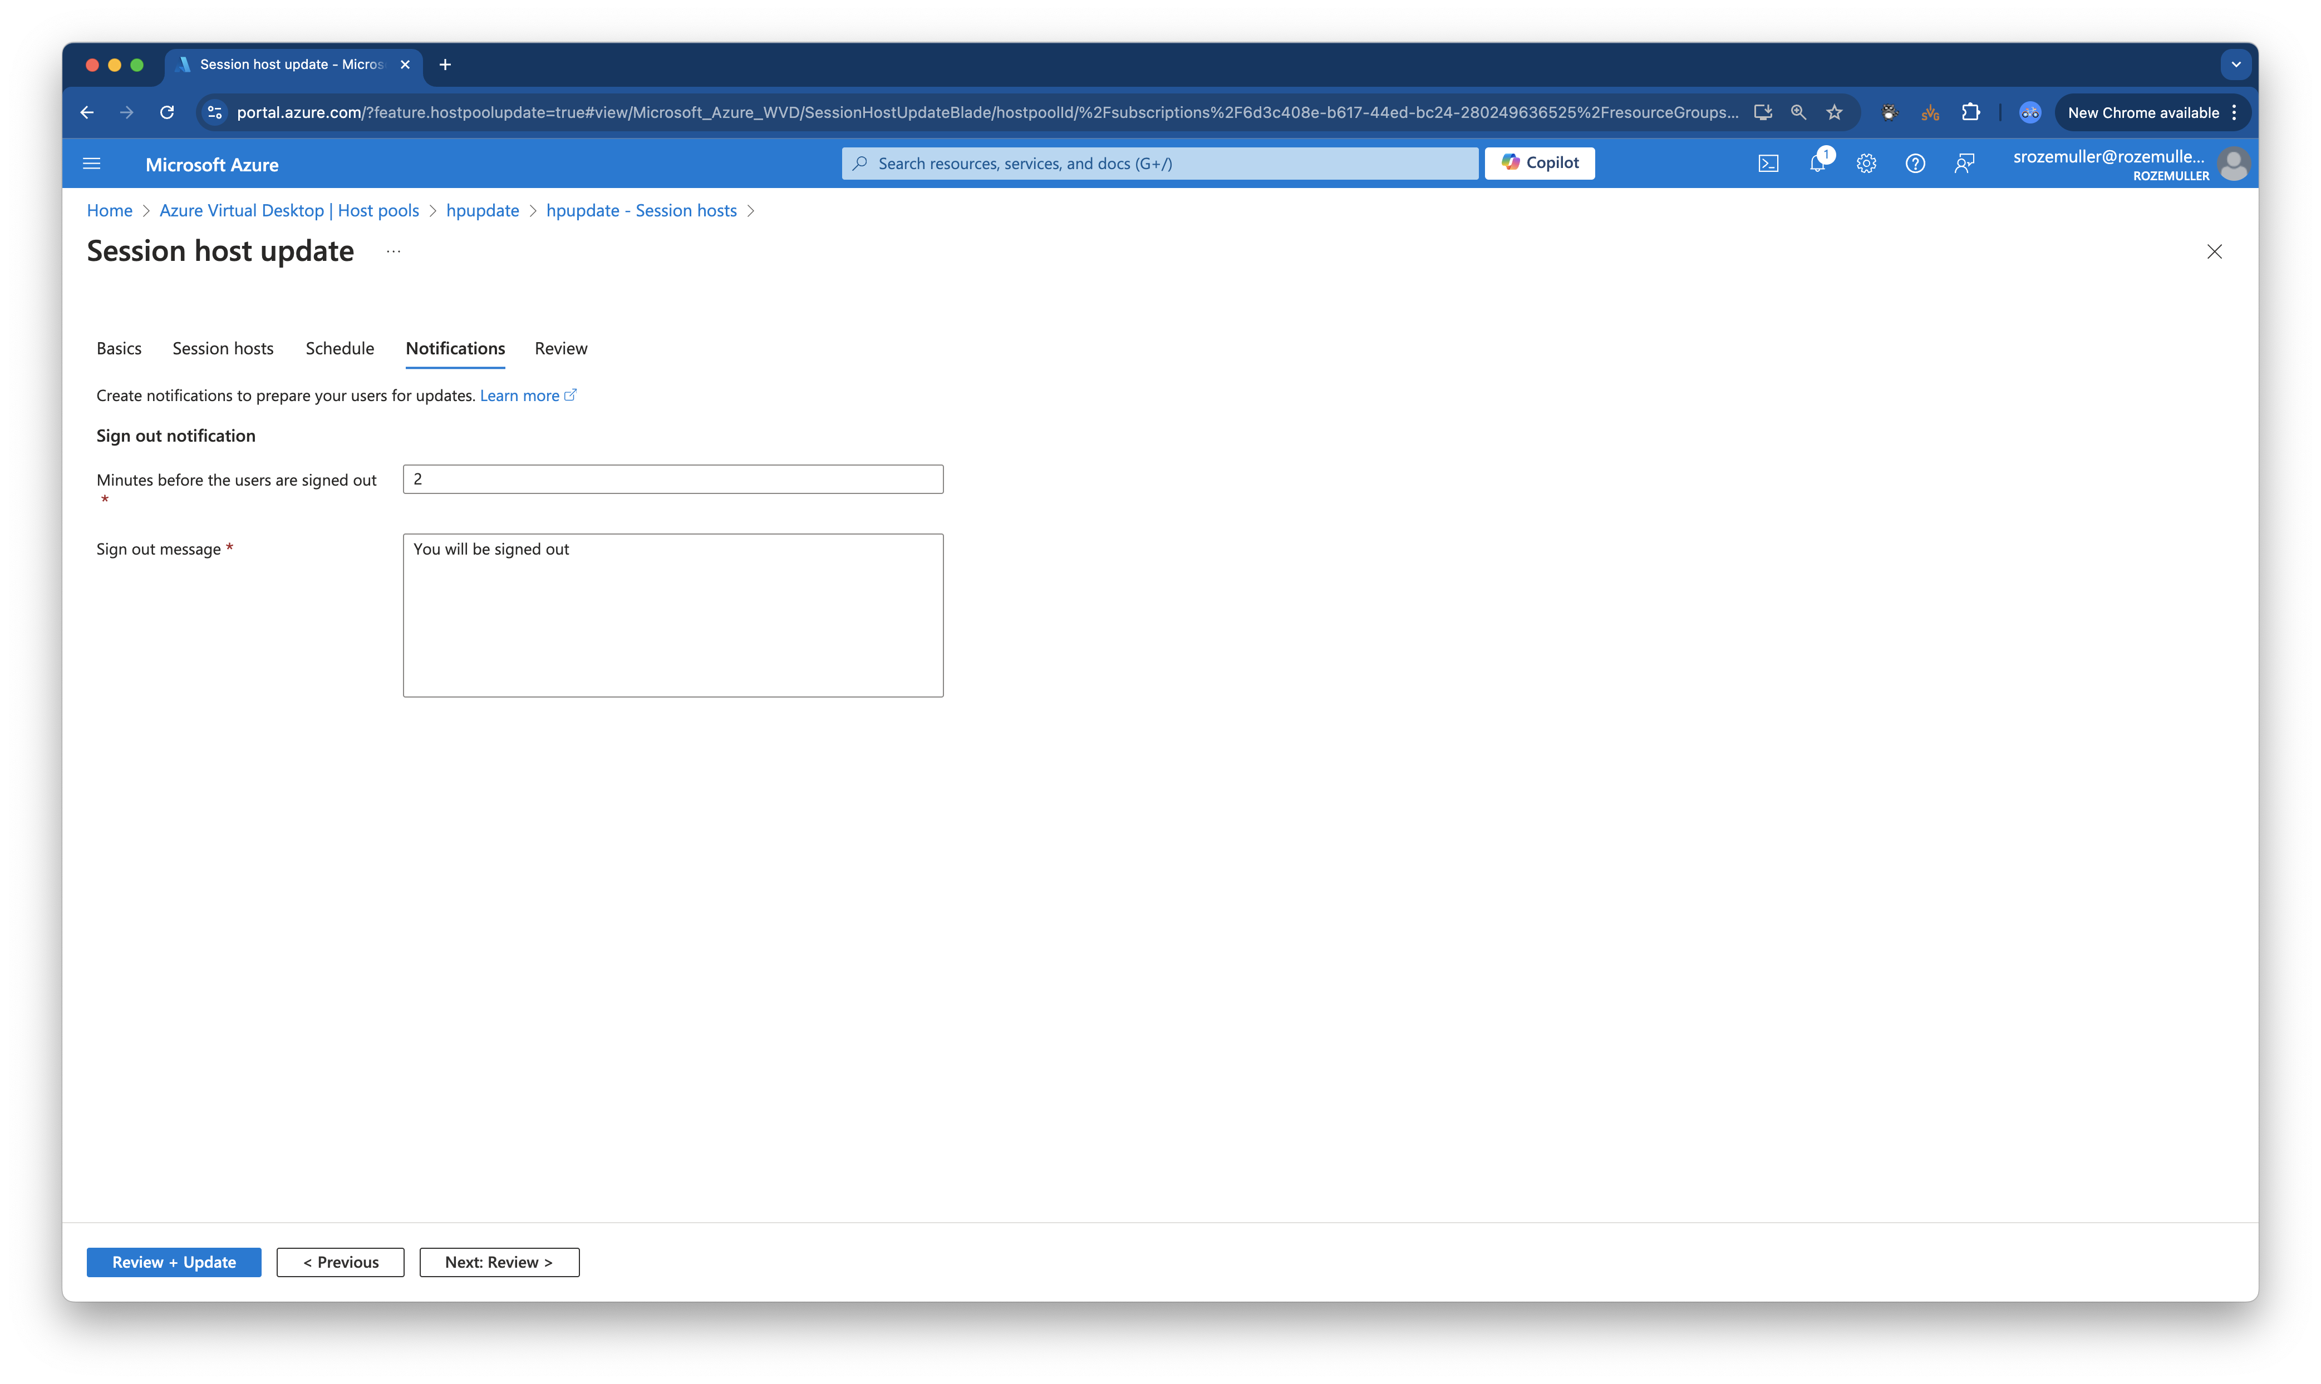
Send notifications

Slide 16
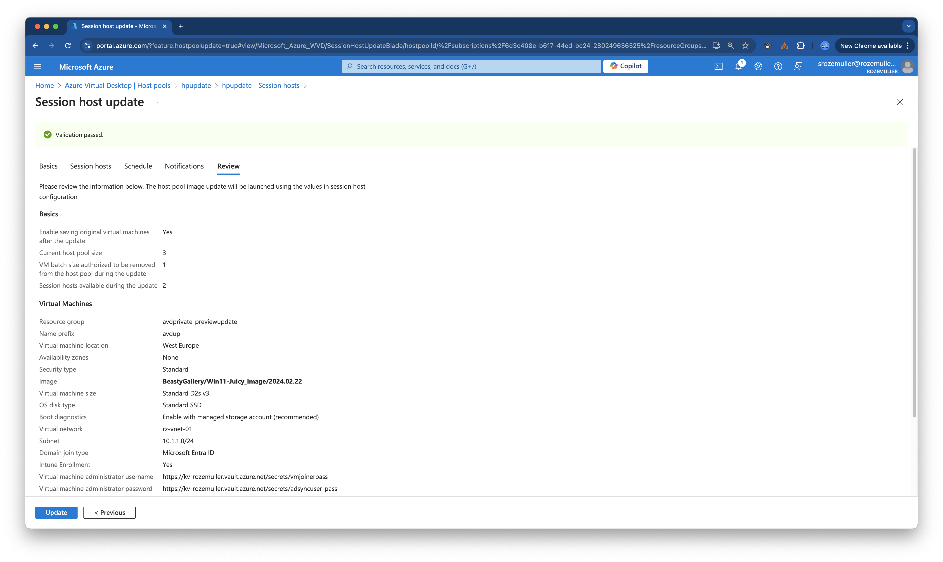
Start update

Slide 17
Monitor the process

Slide 18
Host Pool Update & Automation

Slide 19
Using PowerShell
PS> Connect-Avd
PS> Start-AvdHostpoolUpdate

Slide 20
Demo Host pool update
Using the portal
In Automation

Slide 21
Host Pool Update Rollback
How to rollback the image version. Restore in the portal is not available (yet)

Slide 23


Slide 24









